Slide 1
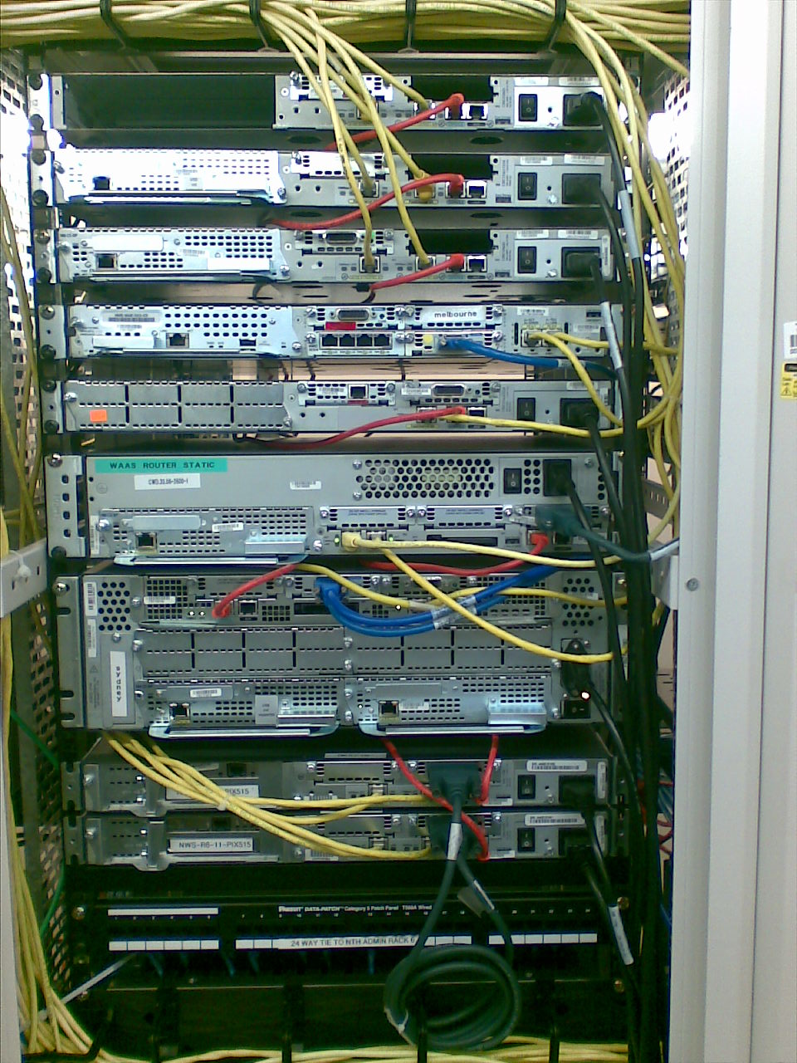
Notes:
Purpose: This slide presents the show interfaces command, which indicates whether the network is operating at the physical and data link layers. The command output is interpreted later in this chapter.
Emphasize: The top line of the output tells us that the line is up. A few lines down, the output provides the IP address, and below that some characteristics like BW for bandwidth, and DLY for delay. On the next line down, we find an encapsulation type of ARPA. ARPA means Ethernet II, which is the default IP encapsulation type for Ethernet interfaces on Cisco routers.
A runt is an Ethernet frame that is too small to be legal (less than 64 bytes), and a giant is an Ethernet frame that is too big (greater than 1518 bytes).

Slide 2
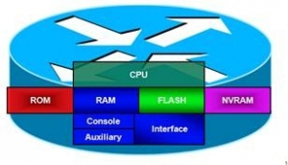
Router Components
CPU
POST
Bootstrap
Mini IOS
ROM
RAM
FLASH
running-config
IOS
NVRAM
startup-config
Interface
Power-On Self-test
Mini IOS used to ROM Monitor > recovery password, upgrade IOS
Notes:
Note:
RAM—Packet buffers, running configurations, running Cisco IOS
ROM—POST, ROM monitor, baby Cisco IOS (Rxboot)
NVRAM—Backup configurations, config register
Flash—Cisco IOS
Flash memory is nonvolatile. It behaves like a file system. It is more expensive than NVRAM. It is readable and writeable. The 2500 routers run from Flash. If it is running Cisco IOS from Flash, then the Flash is in the readable state. Use the boot system command to boot Cisco IOS from a TFTP server so the 2500 can run from RAM if you need to write or erase Flash online.

Slide 3
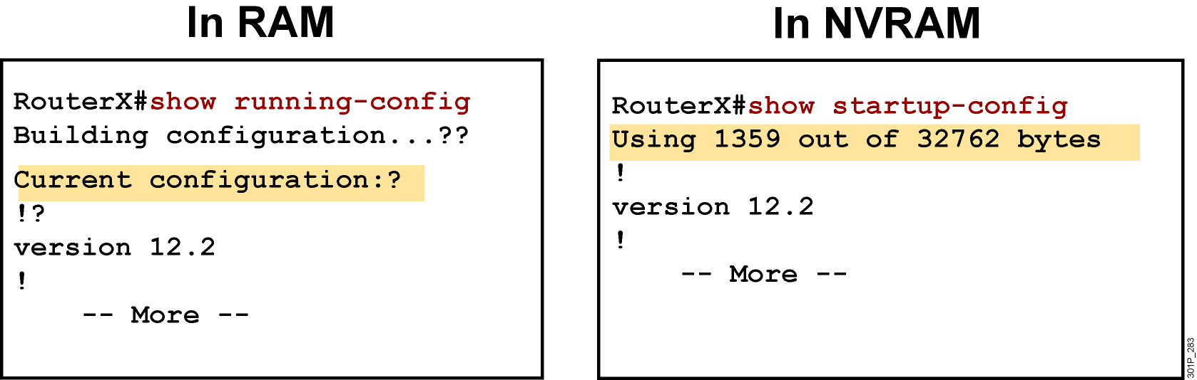
show configuration
Notes:
Purpose: This slide is a repeated slide from Chapter 4, “Operating and Configuring a Cisco IOS Device.”

Slide 4
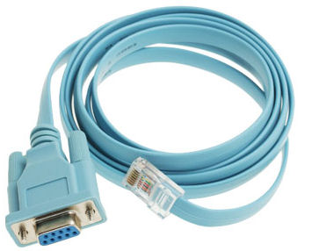


Step config
Console
Rollover
Null-modem
HyperTerminal
CRT
Putty
COM
RJ-45
CONSOLE
Start → Program → Accessories → Communication → HyperTerminal
Notes:
Emphasize: Here is a list of some of the configuration modes available.
For a complete list of the router configuration modes, refer to the Cisco Documentation CD-ROM.

Slide 5
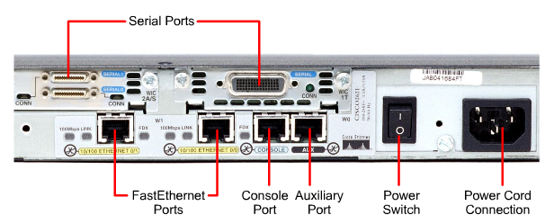
Console Port

Slide 6
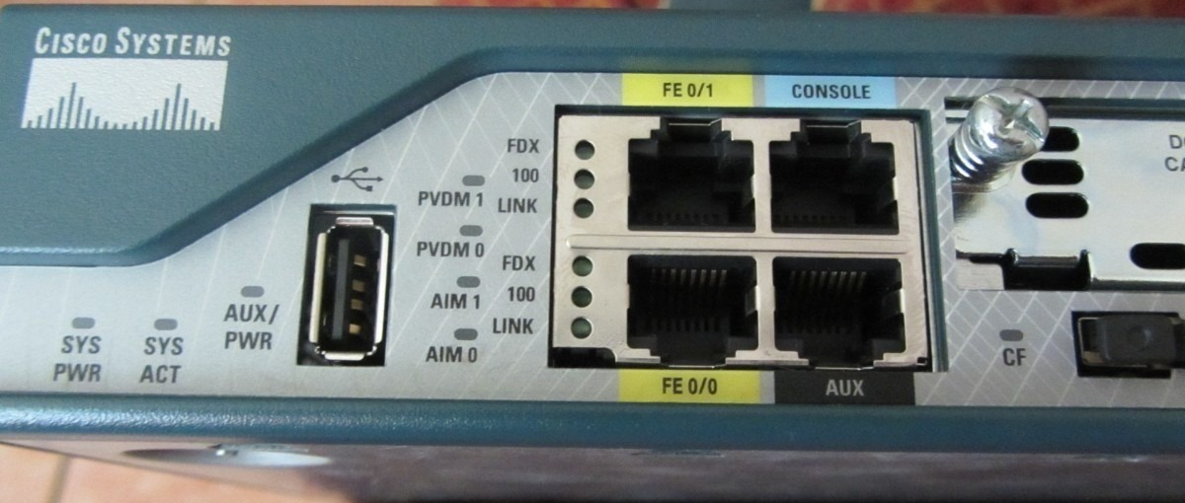
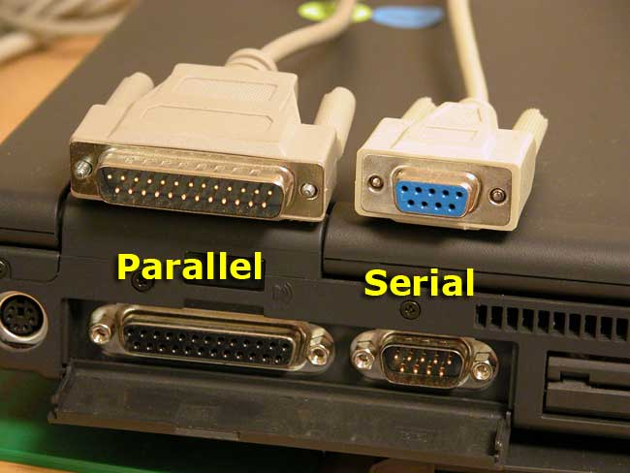
RJ45
COM

Slide 7
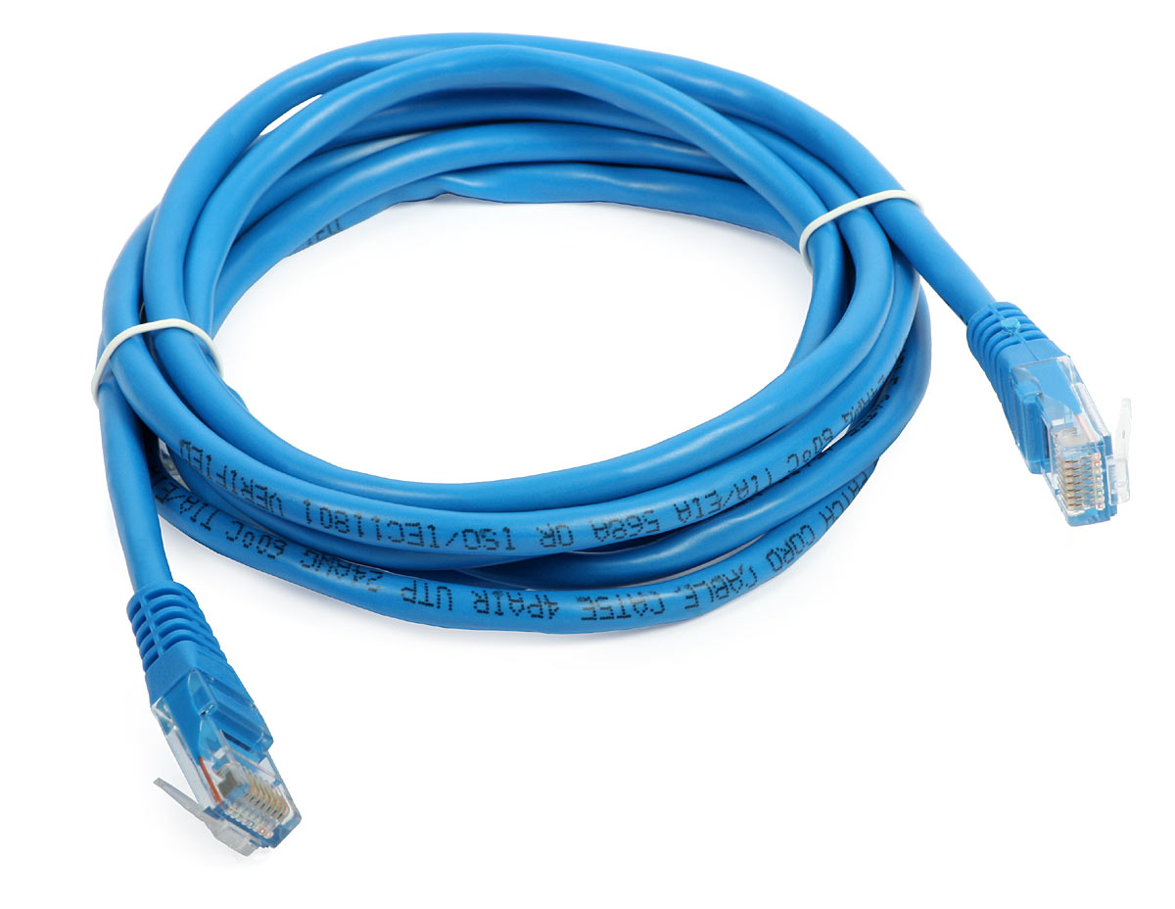
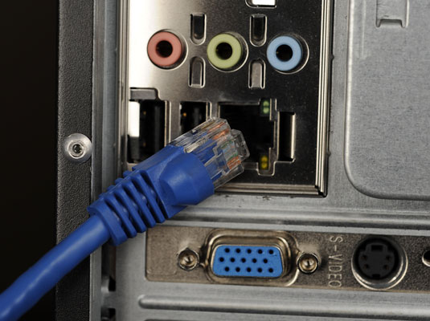

Slide 8
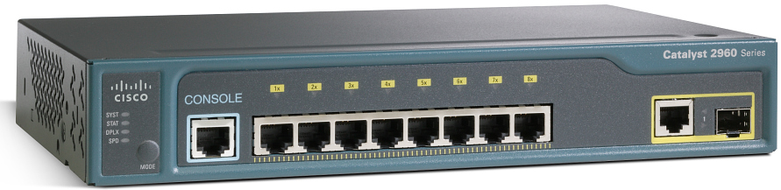

Slide 9
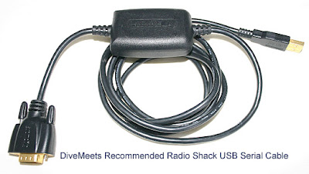
Console Port
Notes:
Emphasize: Here is a list of some of the configuration modes available.
For a complete list of the router configuration modes, refer to the Cisco Documentation CD-ROM.

Slide 10
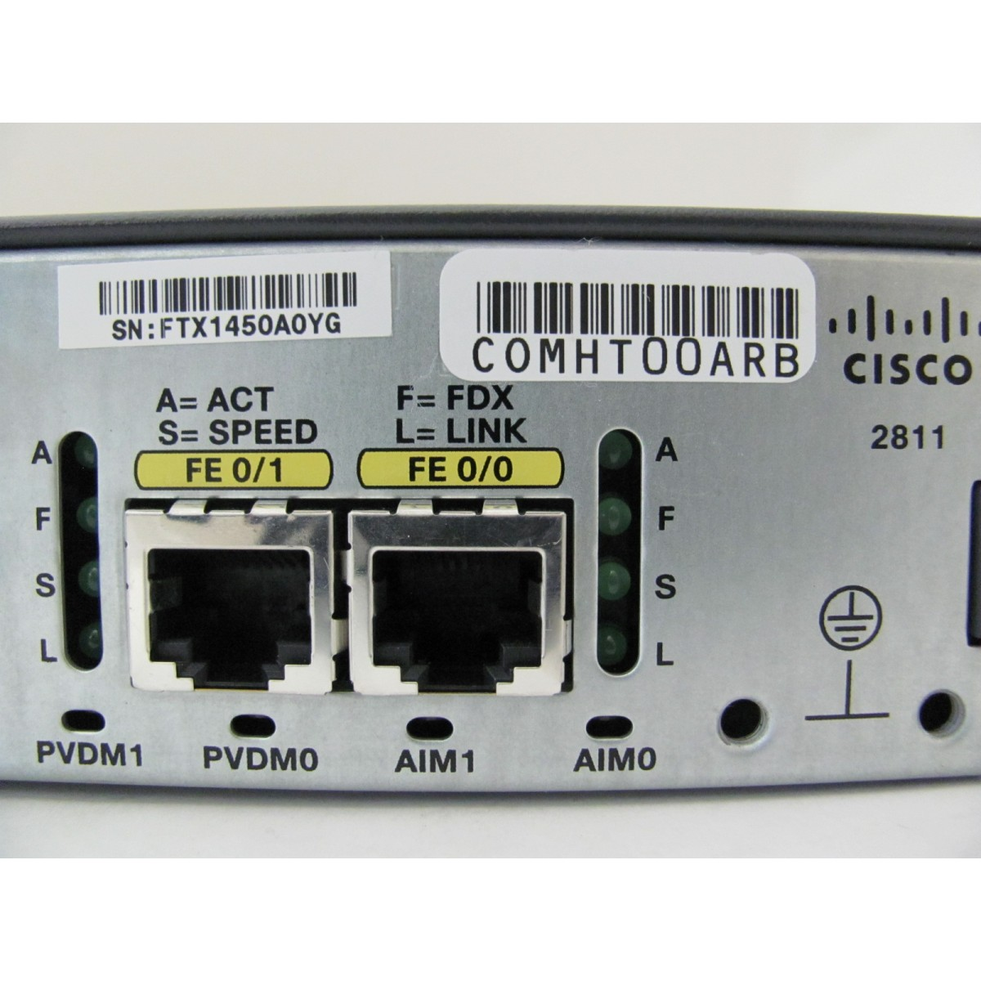
FastEthernet Port
Notes:
Emphasize: Here is a list of some of the configuration modes available.
For a complete list of the router configuration modes, refer to the Cisco Documentation CD-ROM.

Slide 11
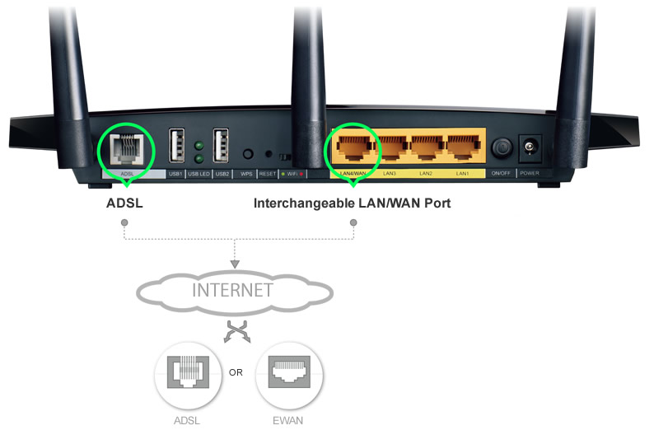
RJ11
Notes:
Emphasize: Here is a list of some of the configuration modes available.
For a complete list of the router configuration modes, refer to the Cisco Documentation CD-ROM.

Slide 12
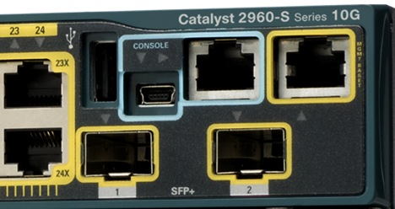
Console Port
Mini USB
Notes:
Emphasize: Here is a list of some of the configuration modes available.
For a complete list of the router configuration modes, refer to the Cisco Documentation CD-ROM.

Slide 13
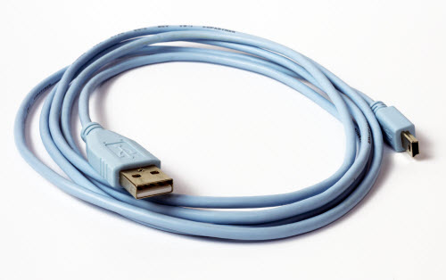
Console Port
Notes:
Emphasize: Here is a list of some of the configuration modes available.
For a complete list of the router configuration modes, refer to the Cisco Documentation CD-ROM.

Slide 14
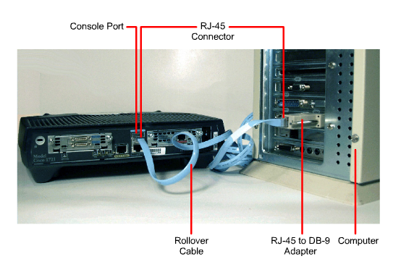
Console Connection

Slide 15
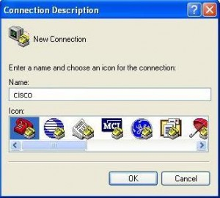

Slide 16
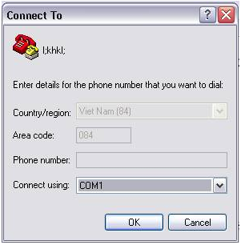
Notes:
Emphasize: Here is a list of some of the configuration modes available.
For a complete list of the router configuration modes, refer to the Cisco Documentation CD-ROM.

Slide 17
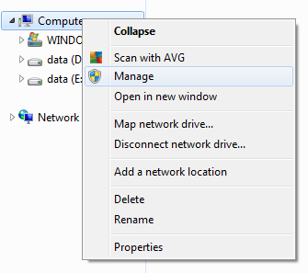
Notes:
Emphasize: Here is a list of some of the configuration modes available.
For a complete list of the router configuration modes, refer to the Cisco Documentation CD-ROM.

Slide 18
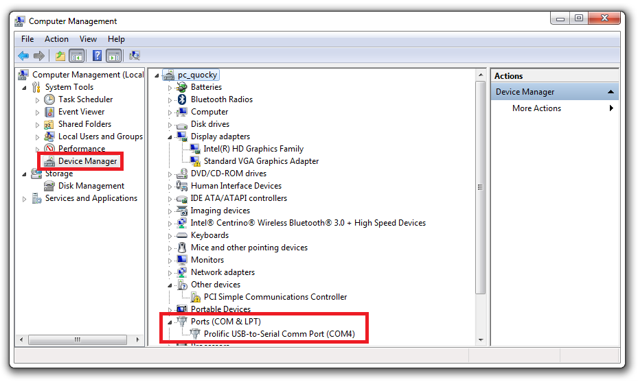
Notes:
Emphasize: Here is a list of some of the configuration modes available.
For a complete list of the router configuration modes, refer to the Cisco Documentation CD-ROM.

Slide 19
Notes:
Emphasize: Here is a list of some of the configuration modes available.
For a complete list of the router configuration modes, refer to the Cisco Documentation CD-ROM.

Slide 20
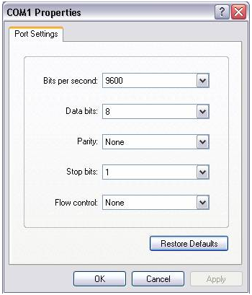
Notes:
Emphasize: Here is a list of some of the configuration modes available.
For a complete list of the router configuration modes, refer to the Cisco Documentation CD-ROM.

Slide 21
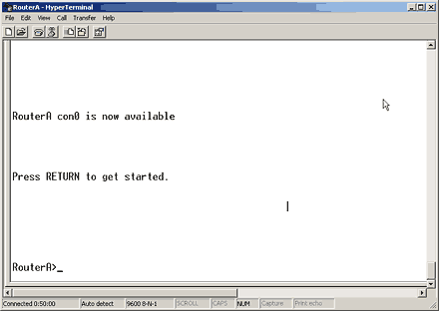
Notes:
Emphasize: Here is a list of some of the configuration modes available.
For a complete list of the router configuration modes, refer to the Cisco Documentation CD-ROM.

Slide 22
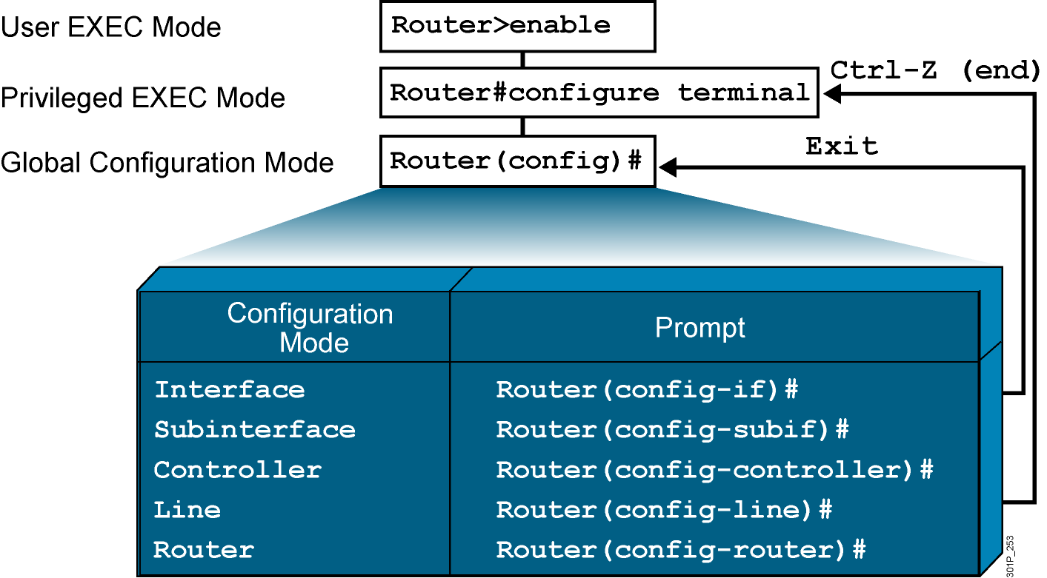
Router Modes
Notes:
Emphasize: Here is a list of some of the configuration modes available.
For a complete list of the router configuration modes, refer to the Cisco Documentation CD-ROM.

Slide 23
User vs Privilege EXEC Mode
Router>
exit
5 command show
Press RETURN to get started.
Router>
enable
Router#
100 command show
Router> (angle bracket sign)
Router# (pound sign)
Notes:
Emphasize: Here is a list of some of the configuration modes available.
For a complete list of the router configuration modes, refer to the Cisco Documentation CD-ROM.

Slide 24
Router Hostname
Global Configuration Mode
Router#
configure terminal
Router(config)#
hostname VnPro
VnPro(config)#
hostname Cisco
Cisco(config)#
Notes:
Emphasize: Here is a list of some of the configuration modes available.
For a complete list of the router configuration modes, refer to the Cisco Documentation CD-ROM.

Slide 25
Password Console vs Enable
Router>
exit
Password:
Router>
enable
Password:
Router#
Router(config)#
line console 0
Router(config-line)#
password vnpro
Router(config-line)#
login
Router(config)#
no
enable password VnPro
Password có đặc tính Case-sensitive
Notes:
Emphasize: Here is a list of some of the configuration modes available.
For a complete list of the router configuration modes, refer to the Cisco Documentation CD-ROM.

Slide 26
Encrypt Password
VnPro(config)# service password-encryption
VnPro#
show running-config
Current configuration : 497 bytes
!
version 12.4
!
hostname VnPro
!
line con 0
login
--More--
cisco
MD7
password cisco
password 7 0822455D0A16
http://www.ifm.net.nz/cookbooks/passwordcracker.html
Notes:
Emphasize: Here is a list of some of the configuration modes available.
For a complete list of the router configuration modes, refer to the Cisco Documentation CD-ROM.

Slide 27
Configure Interface
VnPro(config)#
interface fastethernet 0/0
VnPro(config)#
interface f0/0
VnPro(config-if)#
ip address 10.0.0.1 255.0.0.0
VnPro(config-if)#
no shutdown
VnPro(config-if)#
end
VnPro#
End = Ctrl + Z
Notes:
Emphasize: Here is a list of some of the configuration modes available.
For a complete list of the router configuration modes, refer to the Cisco Documentation CD-ROM.

Slide 28
show ip interface brief
Router# show ip interface brief
Interface IP-Address OK? Method Status Protocol
FastEthernet0/0 10.0.0.1 YES mannual up up
FastEthernet0/1 unassigned YES unset administratively down down
Serial0/0/0 unassigned YES unset administratively down down
Serial0/1/0 unassigned YES unset administratively down down
Serial0/2/0 unassigned YES unset administratively down down
Serial0/3/0 unassigned YES unset administratively down down
Router# ping 10.0.0.2
Notes:
Purpose: This slide presents the show interfaces command, which indicates whether the network is operating at the physical and data link layers. The command output is interpreted later in this chapter.
Emphasize: The top line of the output tells us that the line is up. A few lines down, the output provides the IP address, and below that some characteristics like BW for bandwidth, and DLY for delay. On the next line down, we find an encapsulation type of ARPA. ARPA means Ethernet II, which is the default IP encapsulation type for Ethernet interfaces on Cisco routers.
A runt is an Ethernet frame that is too small to be legal (less than 64 bytes), and a giant is an Ethernet frame that is too big (greater than 1518 bytes).

Slide 29
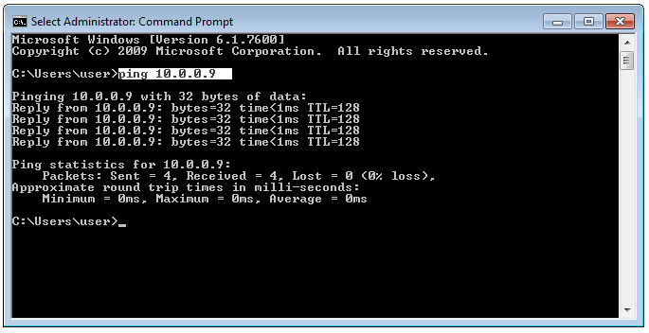
Keepalive
10.0.0.1
10.0.0.2
Router# show interfaces f0/0
f0/0 is up, line protocol is up
Hardware is Lance, address is 00e0.1e5d.ae2f (bia 00e0.1e5d.ae2f)
Internet address is 10.0.0.1/8
MTU 1500 bytes, BW 100000 Kbit, DLY 1000 usec, rely 255/255, load 1/255
Encapsulation ARPA, loopback not set, keepalive set (10 sec)
............
Router# ping 10.0.0.2
Type escape sequence to abort.
Sending 5, 100-byte ICMP Echos to 10.0.0.10, timeout is 2 seconds:
!!!!!
Success rate is 100 percent (5/5), round-trip min/avg/max = 4/4/4 ms

Slide 30
Save Config
write memory
VnPro#
copy running-config startup-config
Destination filename [startup-config]?
VnPro#
reload
Notes:
Emphasize: Here is a list of some of the configuration modes available.
For a complete list of the router configuration modes, refer to the Cisco Documentation CD-ROM.

Slide 31
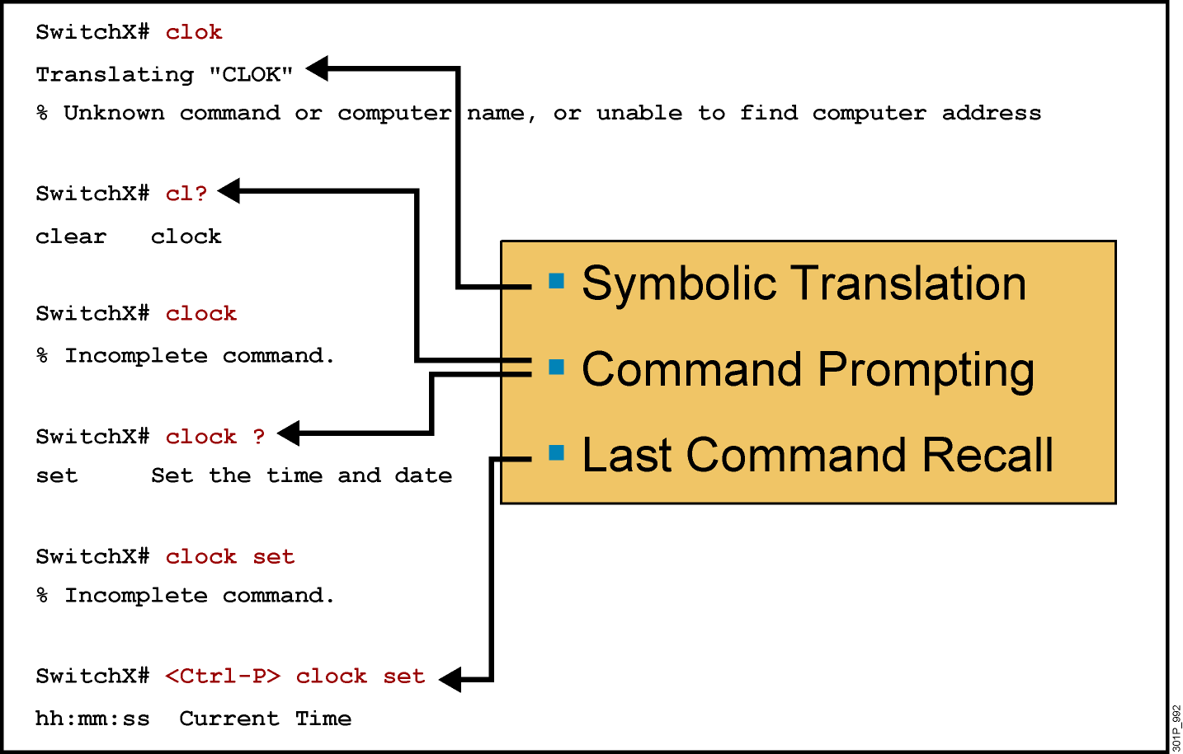
Context-Sensitive Help
Notes:
Slide 1 of 2
Emphasize: Suppose you want to set the router clock. If you do not know the command, use context-sensitive help to check the syntax for setting the clock. The help output shows that the set keyword is required. Next, check the syntax for entering the time.
Now enter the current time using hours, minutes, and seconds, as shown.
The system indicates that you need to provide additional arguments to complete the command. Press Ctrl-P (or Up arrow) to repeat the previous command entry automatically. Then add a space and a question mark (?) to reveal the additional arguments.
Now you can complete the command entry.
The caret symbol (^) and help response indicate an error. To list the correct syntax, reenter the command up to the point where the error occurred, and then enter a question mark (?).
Enter the year using the correct syntax and press Return to execute the command.
Note that the user interface provides syntax checking in the form of an error location indicator (^). The caret symbol character appears at the point in the command string where you entered an incorrect command, keyword, or argument. The error location indicator and interactive help system allow you to find and correct syntax errors easily.

Slide 32
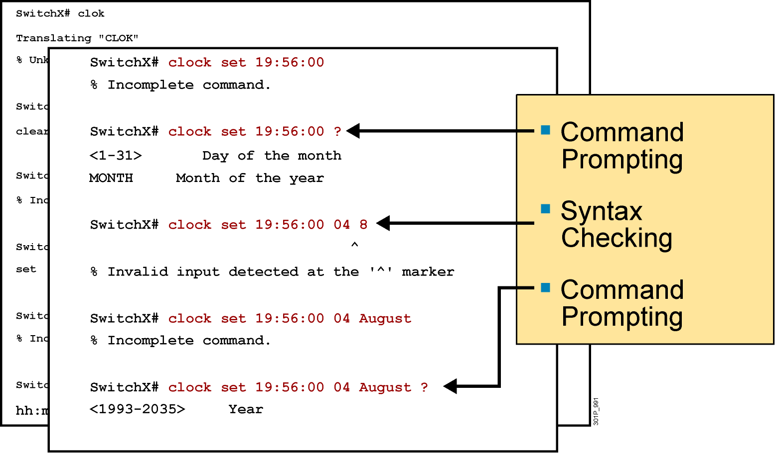
Context-Sensitive Help (Cont.)
Notes:
Slide 2 of 2

Slide 33
Erase config & Reload
VnPro#
erase startup-config
Erasing the nvram filesystem will remove all configuration files! Continue? [confirm]
VnPro#
reload
Proceed with reload? [confirm]
--- System Configuration Dialog ---
Continue with configuration dialog? [yes/no]:
no
Ctrl + C để bỏ qua Initial Setup
Notes:
Emphasize: Here is a list of some of the configuration modes available.
For a complete list of the router configuration modes, refer to the Cisco Documentation CD-ROM.

Slide 34
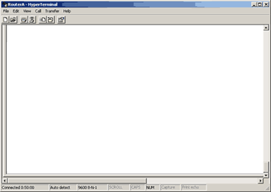

Note
Router# ping 10.0.0.2
console
Con 0
Com
f0/0
NIC
10.0.0.1
10.0.0.2
C:\> ping 10.0.0.1
Notes:
Emphasize: As you use CDP and Telnet, you should note the information retrieved from the devices you successfully contacted. Documenting that information helps put the network into a visual perspective, and can be referenced at a later time.
This concludes the network discovery portion of the chapter. In the next section, we will discuss configuration file and Cisco IOS image management.

Slide 35
logging synchronous
VnPro#
configure ter
%SYS-5-CONFIG_I: Configured from console by console
minal
VnPro(config)#
line console 0
VnPro(config-line)#
logging synchronous
VnPro#
configure ter
%SYS-5-CONFIG_I: Configured from console by console
VnPro#
configure ter
no logging console

Slide 36
logging synchronous
10.0.12.0/24
R1
R2
R1# telnet 10.0.12.2
R2# debug ip packet
*Mar 1 00:09:38.035: IP: tableid=0, s=10.0.12.1 (FastEthernet0/0), d=10.0.12.2 (FastEthernet0/0), routed via RIB
*Mar 1 00:09:38.035: IP: s=10.0.12.1 (FastEthernet0/0), d=10.0.12.2 (FastEthernet0/0), len 41, rcvd 3
*Mar 1 00:09:38.039: IP: tableid=0, s=10.0.12.2 (local), d=10.0.12.1 (FastEthernet0/0), routed via FIB
*Mar 1 00:09:38.039: IP: s=10.0.12.2 (local), d=10.0.12.1 (FastEthernet0/0), len 41, sending

Slide 37
*Mar 1 00:09:38.035: IP: tableid=0, s=10.0.12.1 (FastEthernet0/0), d=10.0.12.2 (FastEthernet0/0), routed via RIB
*Mar 1 00:09:38.035: IP: s=10.0.12.1 (FastEthernet0/0), d=10.0.12.2 (FastEthernet0/0), len 41, rcvd 3
*Mar 1 00:09:38.039: IP: tableid=0, s=10.0.12.2 (local), d=10.0.12.1 (FastEthernet0/0), routed via FIB
*Mar 1 00:09:38.039: IP: s=10.0.12.2 (local), d=10.0.12.1 (FastEthernet0/0), len 41, sending
10.0.12.0/24
R1
R2
R1# telnet 10.0.12.2
R2# debug ip packet
R2# terminal monitor
R2# terminal no monitor
*Mar 1 00:09:38.035: IP: tableid=0, s=10.0.12.1 (FastEthernet0/0), d=10.0.12.2 (FastEthernet0/0), routed via RIB
*Mar 1 00:09:38.035: IP: s=10.0.12.1 (FastEthernet0/0), d=10.0.12.2 (FastEthernet0/0), len 41, rcvd 3
*Mar 1 00:09:38.039: IP: tableid=0, s=10.0.12.2 (local), d=10.0.12.1 (FastEthernet0/0), routed via FIB
*Mar 1 00:09:38.039: IP: s=10.0.12.2 (local), d=10.0.12.1 (FastEthernet0/0), len 41, sending

Slide 38
ip domain-lookup
Router(config)# ip domain-lookup
Router# cont
Translating "cont"...domain server (255.255.255.255)
% Unknown command or computer name, or unable to find computer address
Router#
Router(config)# no ip domain-lookup
Router# cont
Translating "cont"
% Bad IP address or host name% Unknown command or computer name, or unable to find computer address
Router#

Slide 39
Banner
VnPro#
exit
Press RETURN to get started.
Day la Router VnPro
VnPro>
VnPro(config)#
banner motd “Day la Router Vnpro”
motd = message of the day
Notes:
Emphasize: Here is a list of some of the configuration modes available.
For a complete list of the router configuration modes, refer to the Cisco Documentation CD-ROM.

Slide 40
Configure Interface
VnPro(config)#
interface f0/0
VnPro(config-if)#
description Link to ISP
VnPro#
show running-config
!
interface FastEthernet0/0
ip address 10.0.0.1 255.0.0.0
description Link to ISP
Notes:
Emphasize: Here is a list of some of the configuration modes available.
For a complete list of the router configuration modes, refer to the Cisco Documentation CD-ROM.

