Slide 1

TRƯỜNG CAO ĐẲNG LÝ TỰ TRỌNG TP. HỒ CHÍ MINH

Slide 2

KHOA KHOA HỌC CƠ BẢN

Slide 3

ỦY BAN NHÂN DÂN THÀNH PHỐ HỒ CHÍ MINH
TRƯỜNG CAO ĐẲNG LÝ TỰ TRỌNG TP. HỒ CHÍ MINH
Bậc đào tạo: TRUNG CẤP CHUYÊN NGHIỆP
Tên giảng viên: LÊ NGUYỄN MỸ TRÂM

Slide 4

Good afternoon class 19T2.

Slide 5

good afternoon class 19t2

Slide 6
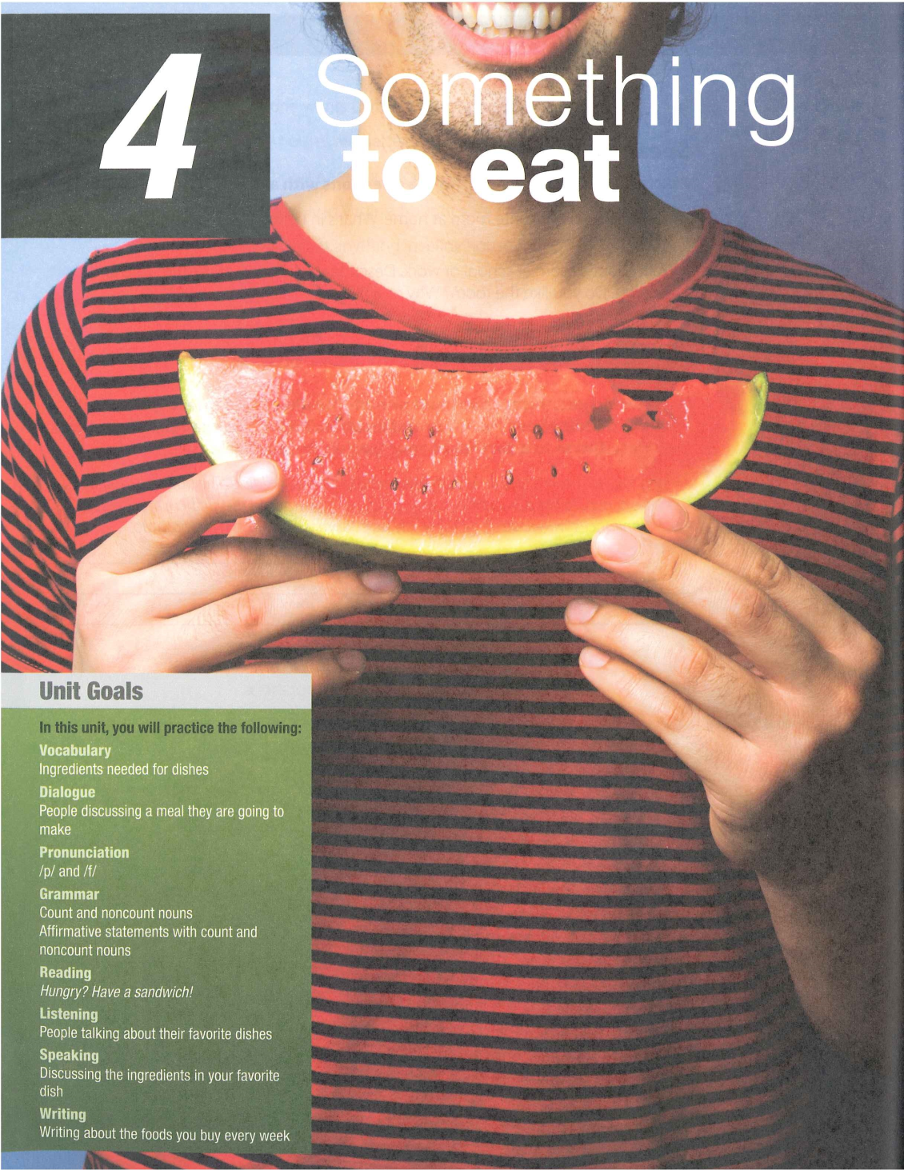

Slide 7
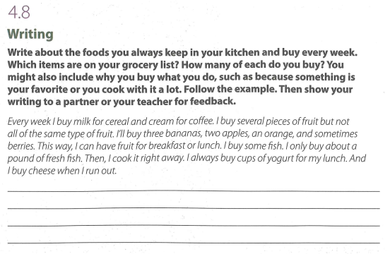

Slide 8

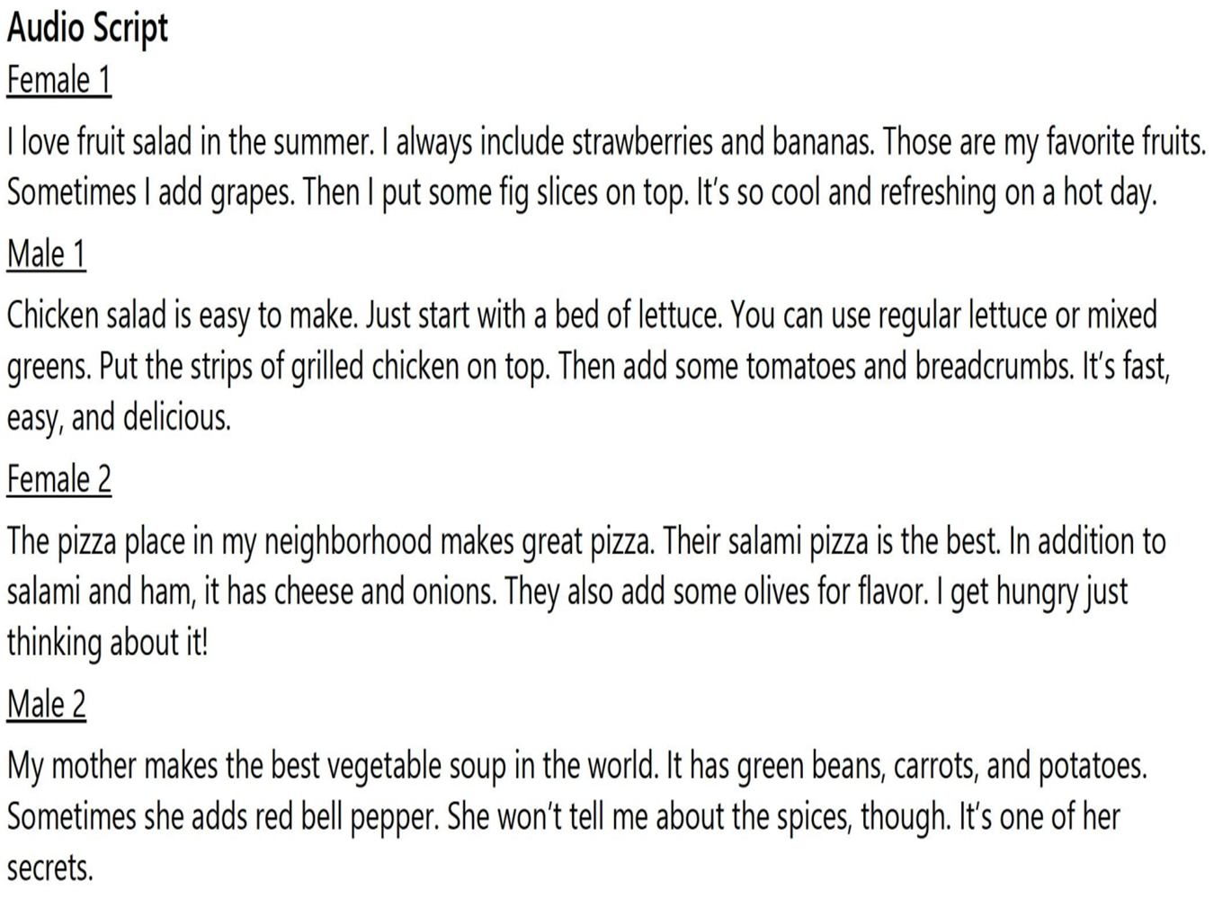

Slide 10
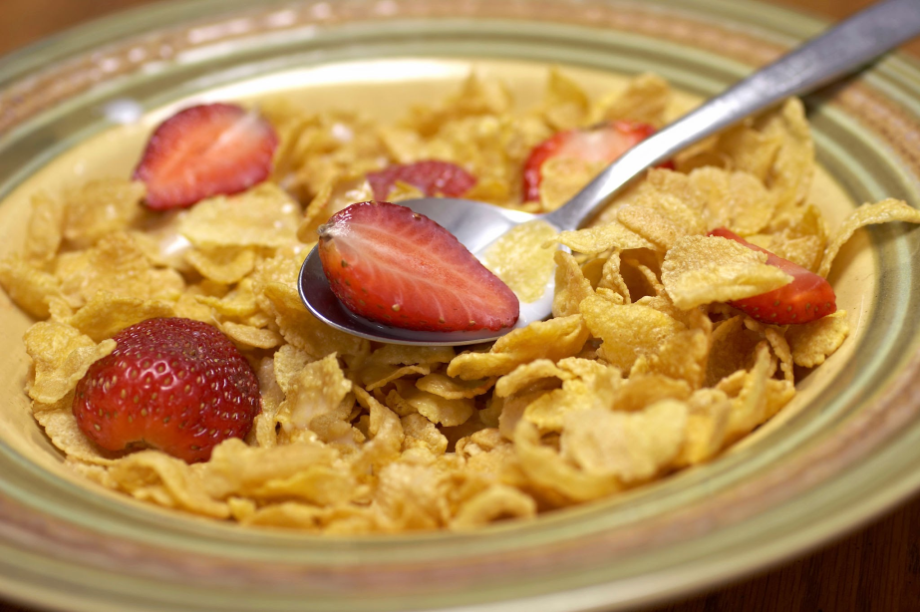
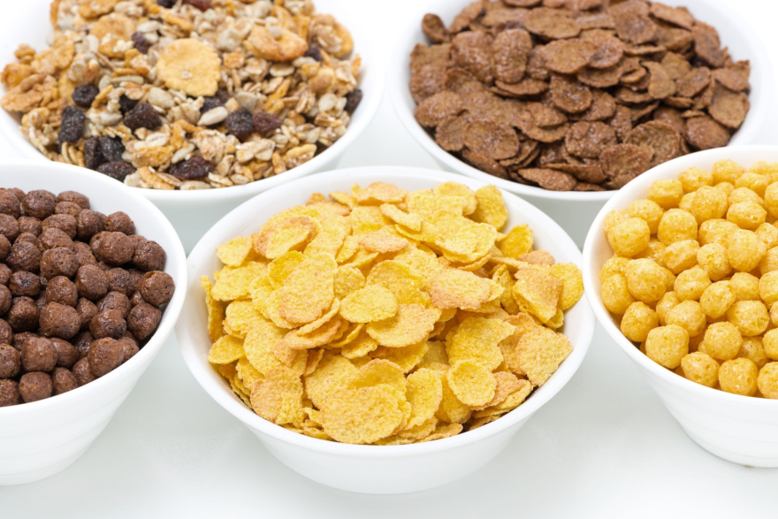
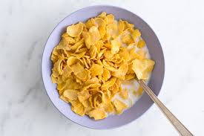
New words:
1. cereal (n)

Slide 11
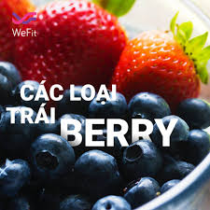
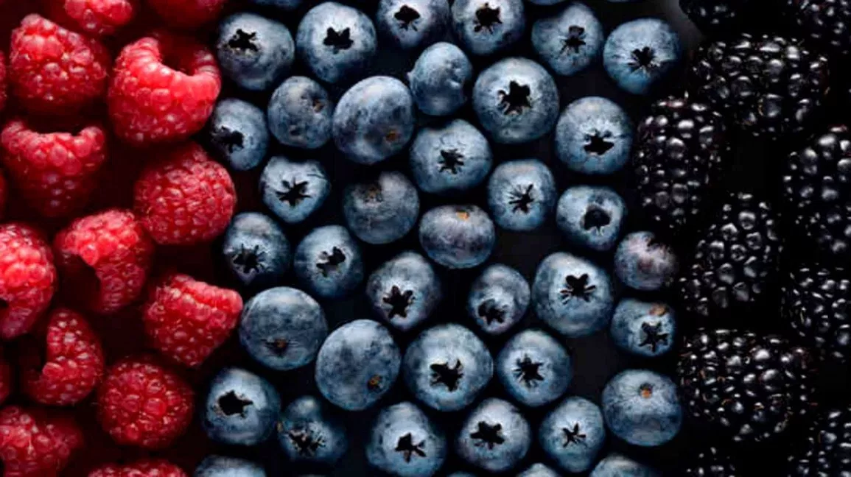
2. berry (n)

Slide 12
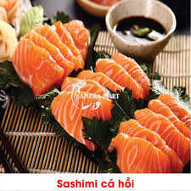
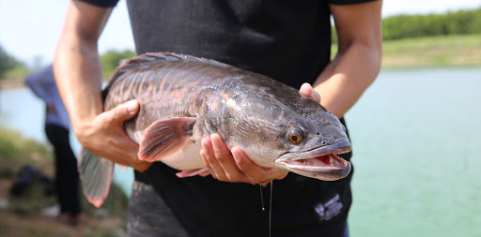
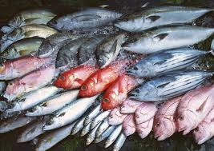
3. fresh fish (n)

Slide 13
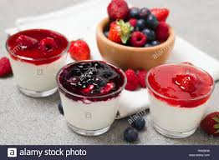
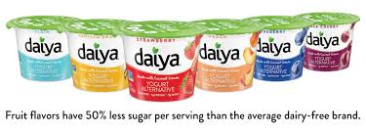
4. cups of yogurt (n)

Slide 14
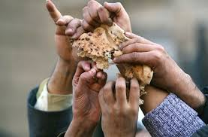
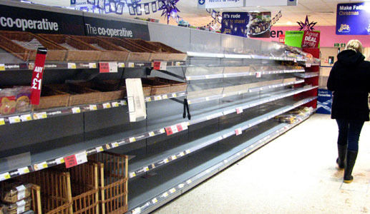
5. run out (v)

Slide 16
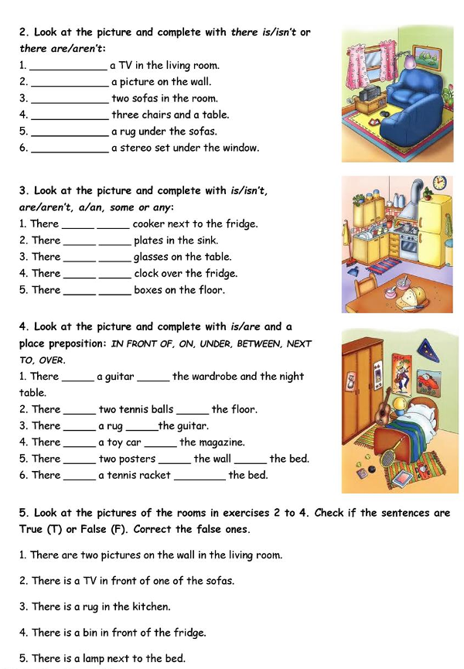
REVIEW

Slide 17
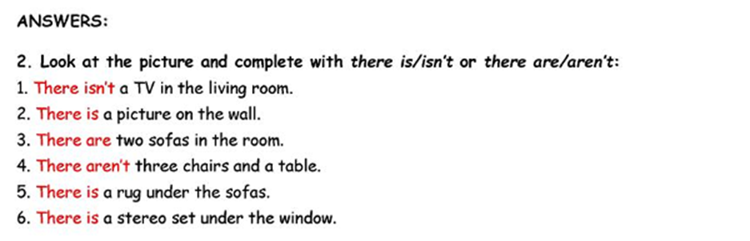
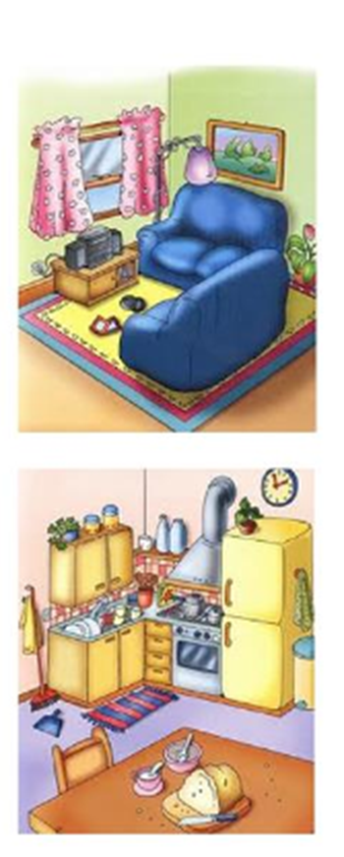

Slide 19
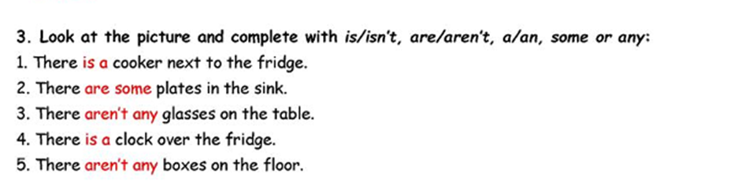

Slide 21
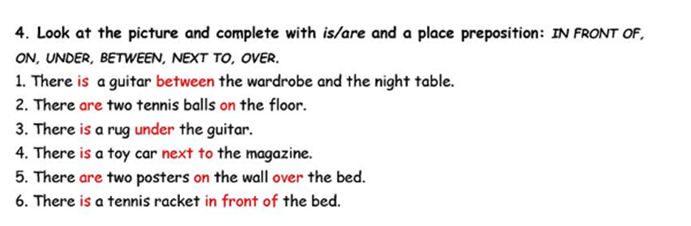
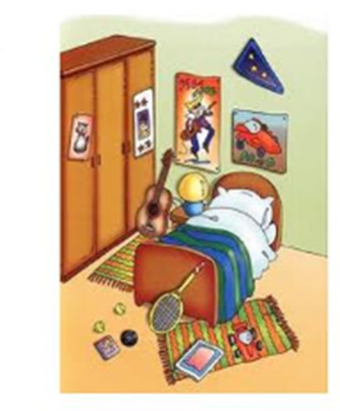

Slide 23
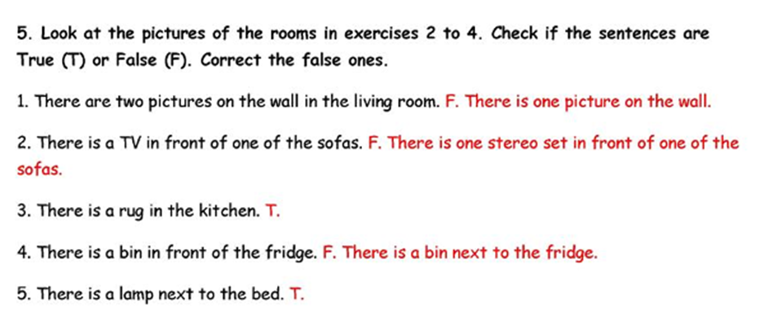

Slide 24
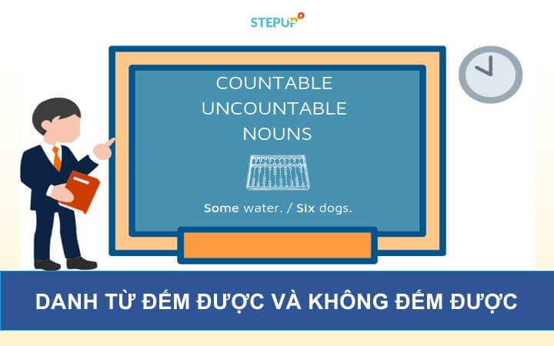

Slide 25
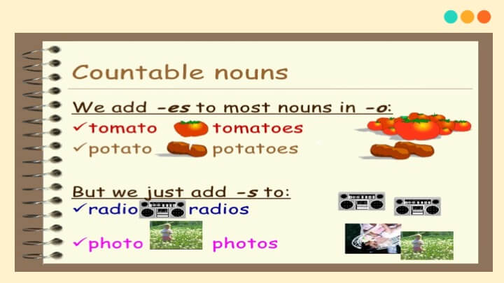

Slide 26
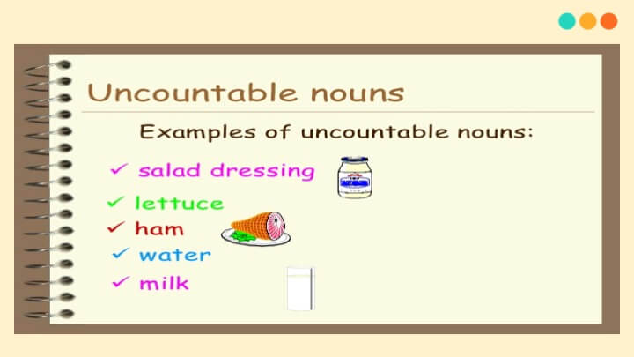

Slide 27
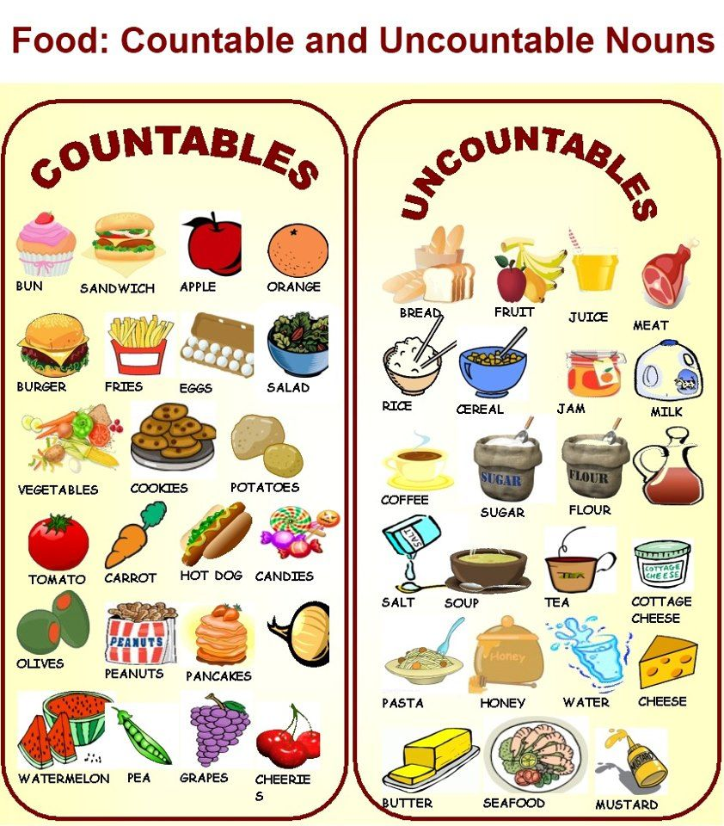

Slide 28
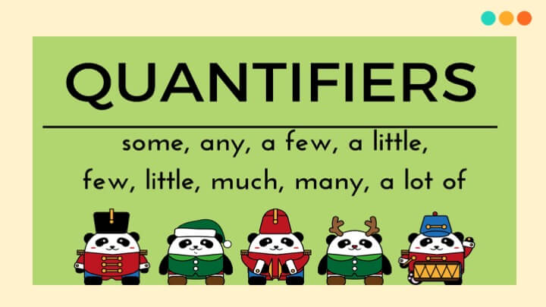

Slide 29
CÁC DANH TỪ CHỈ TẬP HỢP THƯỜNG GẶP
A bar of chocolate: một thanh sô cô la
A bouquet of flower: 1 bó hoa
A bunch of bananas / flowers / grapes / keys: một nải chuối / bó hoa / chùm nho, chùm chìa khóa
A bundle of vegetables/ firewood / papers: một bó rau / bó củi / bọc giấy
A fall of snow / rain: một trận tuyết / mưa rơi
A flight of birds: một đàn chim
A flock of geese / sheep / goats / birds: một đàn ngỗng/cừu/dê/chim

Slide 30
CÁC DANH TỪ CHỈ TẬP HỢP THƯỜNG GẶP
A glass of water: một cốc nước
A litter of puppies: một lứa chó con
A nest of ants: một tổ kiến
A pack of wolves / hounds / grouse / fools: bầy chó sói / chó săn / đàn gà rô trắng / một lũ ngốc
A school / shoal of fish: một đàn cá
A shower of rain: một cơn mưa rào
A stack of wood: một đống gỗ
A swarm of flies / bees: một đàn / bầy ruồi / ong

Slide 31
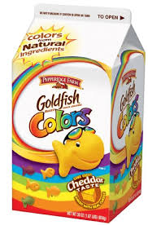
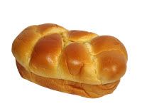
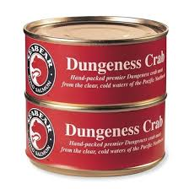
Điền vào mỗi chỗ trống một lượng từ phù hợp được cho dưới đây.
cartons; bag; bottle; bars; loaf; tins
1. Three _____ of juice cost $4.77.
2. Buy me one _____ of bread, please. It’s so cheap.
3. Can you bring me two _____ of crab?

Slide 32
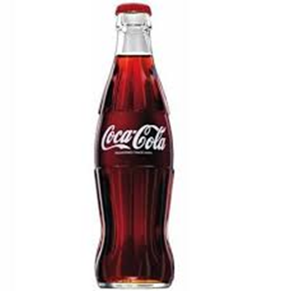
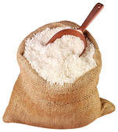
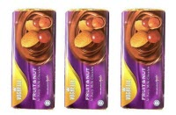
cartons; bag; bottle; bars; loaf; tins
4. I’m thirsty. I will buy a _____
of Coke.
5. Let’s go to the supermarket to buy one _____ of rice.
6. Here are three _____ of chocolate.

Slide 33
Fill in the blans with the following words:
slice some the
cartons pieces some cup bottle the cup some a two some the
1. After school, she has a _____ of bread with _____ butter on it.
2. Mitchell has three _____ of luggage.
3. Maria often has a _____ of tea after dinner.

Slide 34
slice some the cartons
pieces some cup bottle
the cup some a
two some the
4. We need a glass with ________ water in it.
5. We want ________ coffees, please – one white and one brown.
6. They need stop at a garage and put _______ petrol in _______ car.

Slide 35
slice some the cartons
pieces some cup bottle
the cup some a two some the
7. How much is _______ bottle of Pepsi at _______ store?
8. There is a _______ of juice in the kitchen.
9. Can I have a _______ of coffee and of pancake, please?
10. There are _______ hairs in ______ bath.

Slide 36

 ONE - PERIOD TEST 
1. _______ two oranges, four bananas and a cake in the fridge.
There is
There are
There are some
There isn’t

Slide 37
2. _______ a pen, a ruler and a book on the table.
a. There is
b. There are
c. There are some
d. There aren’t

Slide 38
3. _______ hot water in the bottle.
There are
There are some
There aren’t
There is

Slide 39
4. ______ some children in the yard.
There are
There are any
There aren’t
There is

Slide 40
5. ______ many quiz programs on TV these days.
There are some
There are
There are any
There is

Slide 41
6. ______ cheese in that sandwich?
Are there any
Is there a
Is there an
Is there any

Slide 42
7. ______ customers in the store?
Are there some
Are there a
Are there any
Is there any

Slide 43
8. ______ some salt and sugar in this sauce.
There are any
There are
There is any
There is

Slide 44
9. ______ dolphins in the aquarium.
There are any
There isn’t
There aren’t any
There isn’t any

Slide 45
10. ______ an elephant with a tiger in the zoo.
There are some
There are
There is some
There is

Slide 46
11. ______ cheese, seafood and rice in my mom’s basket.
There are some
There is
There is any
There are

Slide 47
12. ______ a big mirror in your younger sister’s room?
Are there
Is there any
Are there any
Is there

Slide 48
13. How many members ______ in your English club?
are there some
there are
are there
is there

Slide 49
14. There is a small ______ adjacent to the house that could be used as an office or studio.
lamp
building
sofa
nightstand

Slide 50
15. He drank two glasses of ______.
fruit juices
hot milks
fruit juice
cold milks

Slide 51
16. Shall I cut you a ______ of bread?
slices
slice
loaves
a loaf

Slide 52
17. I baked three ______ of brown bread yesterday.
slice
loaves
loaf
jars

Slide 53
18. This recipe needs half a ______ of butter.
pound
head
loaf
pint

Slide 54
19. For this recipe choose ten ______ with large caps (= top parts).
breads
ketchups
mustards
mushrooms

Slide 55
20. I've just had some ______.
chocolate
mushroom
jar
green pepper

Slide 56
21. You need one whole head of ______ for this salad.
mayonnaise
lettuce
chicken
ketchup

Slide 57
22. The paper had fallen down ______ the desk and the wall.
across
at
between
on

Slide 58
23. There was a lamp hanging ______ the table.
in
between
over
under

Slide 59
24. There was a really strange man standing ______ me at the train station.
under
between
over
next to

Slide 60
25. They stood ______ a tree (= below its branches) to avoid getting wet.
under
into
on
between

Slide 61
The end of the TEST.
GOODBYE EVERYBODY!
See you next time!
Have a nice week!

Slide 62

Thank you very much
for your cooperation.

