Slide 1

TRƯỜNG CAO ĐẲNG LÝ TỰ TRỌNG TP. HỒ CHÍ MINH

Slide 2

KHOA KHOA HỌC CƠ BẢN

Slide 3

ỦY BAN NHÂN DÂN THÀNH PHỐ HỒ CHÍ MINH
TRƯỜNG CAO ĐẲNG LÝ TỰ TRỌNG TP. HỒ CHÍ MINH
Bậc đào tạo: TRUNG CẤP CHUYÊN NGHIỆP
Tên giảng viên: LÊ NGUYỄN MỸ TRÂM

Slide 4

Good afternoon class 19T2.

Slide 5
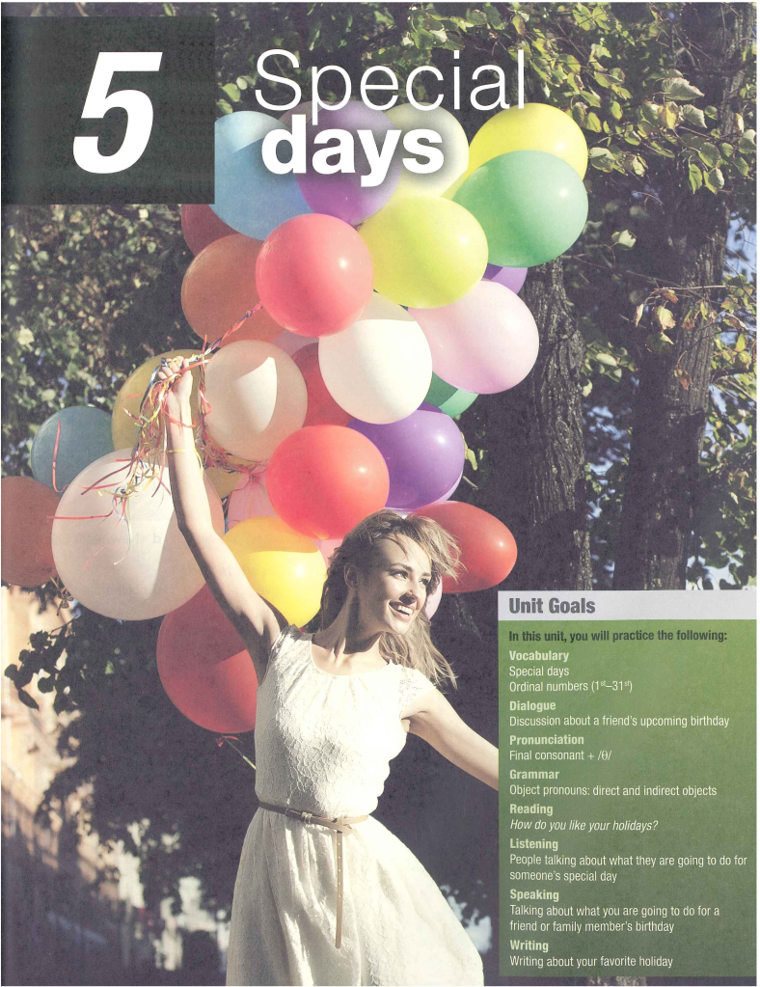

Slide 6

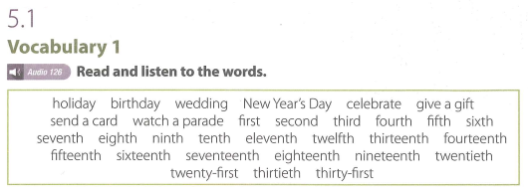
UNIT 5: SPECIAL DAYS

Slide 7
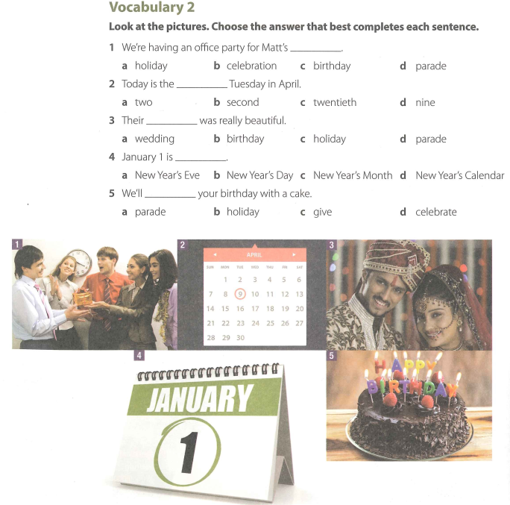

Slide 8
VOCABULARY 2 (KEY)
  1. We're having an office party for Matt's _______ .
  a. holiday b. celebration
  c. birthday d. parade
  2. Today is the _______ Tuesday in April.
  a. two b. second
  c. twentieth d. nine

Slide 9
VOCABULARY 2 (KEY)
  3. Their ______ was really beautiful . a. wedding b. birthday
  c. holiday d. parade
  4. January 1 is _______ .
  a. New Year’s Eve
  b. New Year’s Day
  c. New Year’s Month
  d. New Year’s Calendar

Slide 10
VOCABULARY 2 (KEY)
  5. We’ll _______ your birthday with a cake.
  a. parade
  b. holiday
  c. give
  d. celebrate

Slide 11
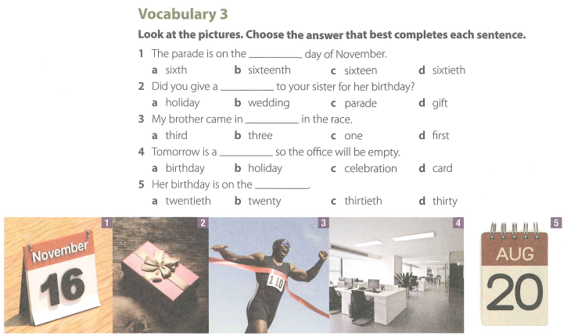

Slide 12
VOCABULARY 3 (KEY)
1. The parade is on the _____ day of November.
a. sixth b. sixteenth
c. sixteen d. sixtieth
2. Did you give a _____ to your sister for her birthday?
a. holiday b. wedding
c. parade d. gift
3. My brother came in _____ in the race.
a. third b three
c. one d. first

Slide 13
VOCABULARY 3 (KEY)
4. Tomorrow is a _____ so the office will be empty.
a. birthday b. holiday
c. celebration d. card
5. Her birthday is on the _____.
a. twentieth b twenty
c. thirtieth d. thirty

Slide 14
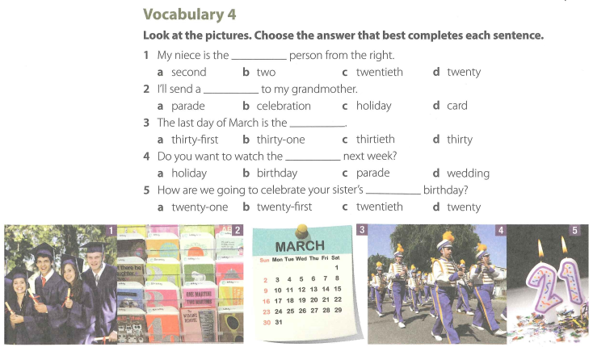

Slide 15
VOCABULARY 4 (KEY)
1. My niece is the _____ person from the right.
a. second b. two
c. twentieth d. twenty
2. I’ll send a _____ to my grandmother.
a. parade b. celebration
c. holiday d. card
3. The last day of March is the_____ .
a. thirty - first b thirty - one
c. thirtieth d. twenty

Slide 16
VOCABULARY 4 (KEY)
4. Do you want to watch the _____ next week?
a. holiday b. birthday
c. parade d. wedding
5. How are we going to celebrate your sister’s _____ birthday?
a. twenty-one b. twenty-first
c. twentieth d. twenty

Slide 17
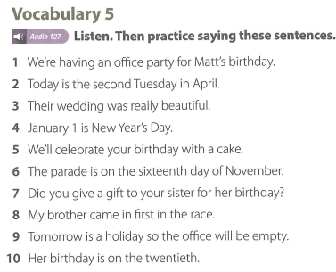

Slide 18
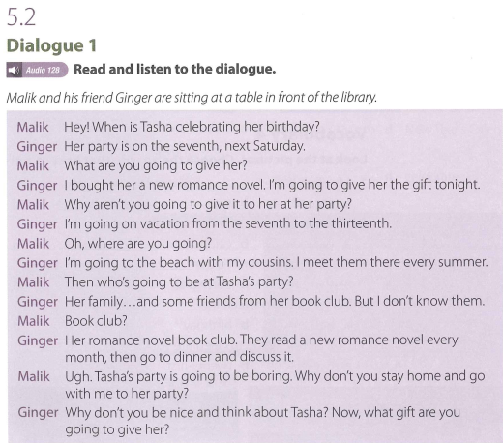

Slide 19
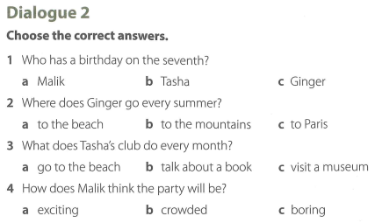

Slide 20
Dialogue 2 (Key)
1. Who has a birthday on the seventh?
a. Malik b. Tasha c. Ginger
2. Where does Ginger go every summer?
a. to the beach b. to the mountains
c. to Paris
3. What does Tasha's club do every month?
a. go to the beach b. talk about a book
c. visit a museum
4. How does Malik think the party will be?
a exciting b crowded c boring

Slide 21

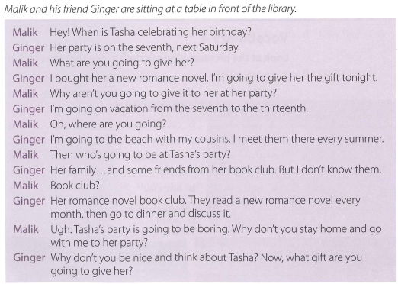

Slide 22
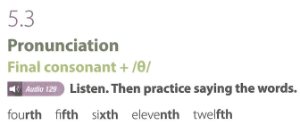

Slide 23
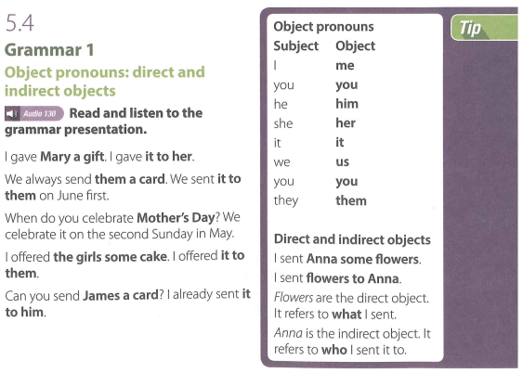

Slide 24
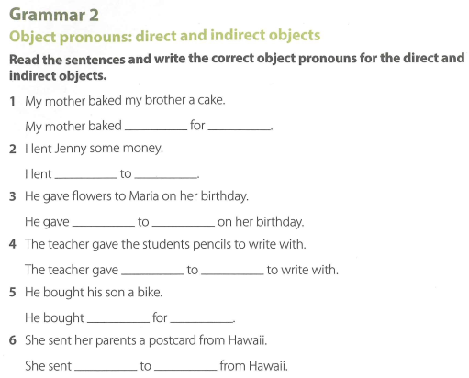

Slide 25
GRAMMAR 2 (KEY)
1. My mother baked my brother a cake.
My mother baked it for him.
2. I lent Jenny some money.
I lent it to her.
3. He gave flowers to Maria on her birthday.
He gave them to her on her birthday.
4. The teacher gave the students pencils to write with.
The teacher gave them to them to write with
5. He bought his son a bike.
He bought it for him.
6. She sent her parents a postcard from Hawaii.
She sent it to them from Hawaii.

Slide 26
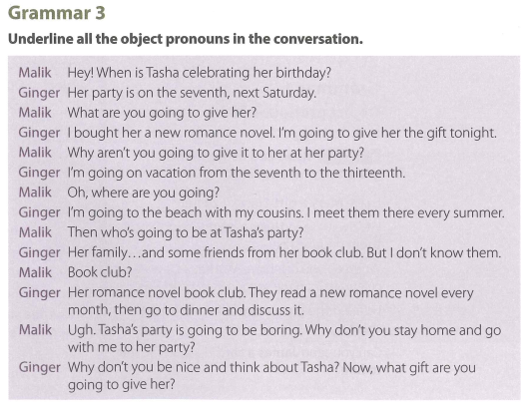

Slide 27
GRAMMAR 3 (KEY)
Malik: Malik: Hey! When is Tasha celebrating her birthday?
Ginger: Her party is on the seventh, next Saturday.
Malik: What are you going to give her?
Ginger: I bought her a new romance novel. I’m going to give her the gift tonight.
Malik: Why aren’t you going to give it to her at her party?
Ginger: I’m going on vacation from the seventh to the thirteenth.
Malik: Oh, where are you going?
Ginger: I’m going to the beach with my cousins. I meet them there every summer.
Malik: Then who’s going to be at Tasha’s party?
Ginger: Her family...and some friends from her book club. But I don’t know them.
Malik: Book club?
Ginger: Her romance novel book club. They read a new romance novel every
month, then go to dinner and discuss it.
Malik: Ugh. Tasha’s party is going to be boring. Why don’t you stay home and go with me to her party?
Ginger: Why don’t you be nice and think about Tasha? Now, what gift are you going to give her?

Slide 28
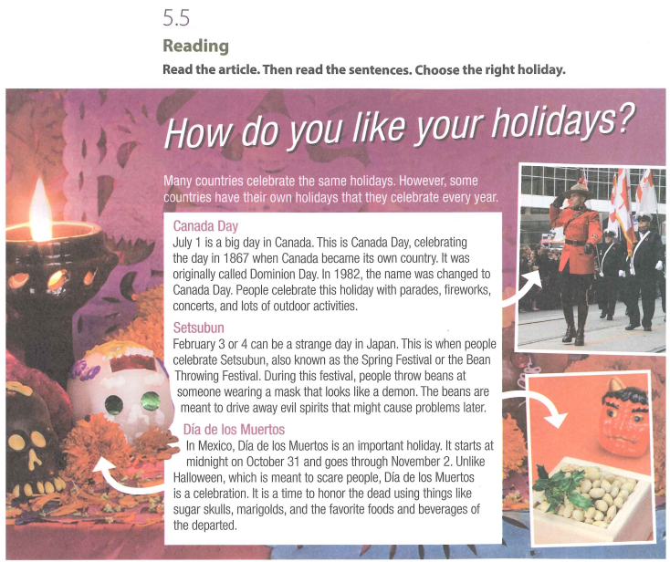

Slide 29
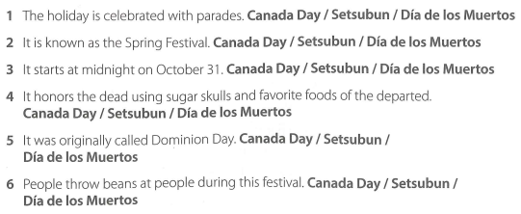

Slide 30
5.5 Reading (Key)
  1. The holiday is celebrated with parades. Canada Day / Setsubun / Día de los Muertos
  2. It is known as the Spring Festival. Canada Day / Setsubun / Día de los Muertos
  3. It starts at midnight on October 31. Canada Day / Setsubun / Día de los Muertos

Slide 31
5.5 Reading (Key)
4. It honors the dead using sugar skulls and favorite foods of the departed. Canada Day / Setsubun / Día de los Muertos
5. lt was originally called Dominion Day. Canada Day / Setsubun / Día de los Muertos
6. People throw beans at people during this festival. Canada Day / Setsubun / Día de los Muertos

Slide 32

Thank you very much
for your cooperation.

