Slide 1

TRƯỜNG CAO ĐẲNG LÝ TỰ TRỌNG TP. HỒ CHÍ MINH

Slide 2

KHOA KHOA HỌC CƠ BẢN

Slide 3

ỦY BAN NHÂN DÂN THÀNH PHỐ HỒ CHÍ MINH
TRƯỜNG CAO ĐẲNG LÝ TỰ TRỌNG TP. HỒ CHÍ MINH
Bậc đào tạo: TRUNG CẤP CHUYÊN NGHIỆP
Tên giảng viên: LÊ NGUYỄN MỸ TRÂM

Slide 4

Good afternoon class 19T2.

Slide 5
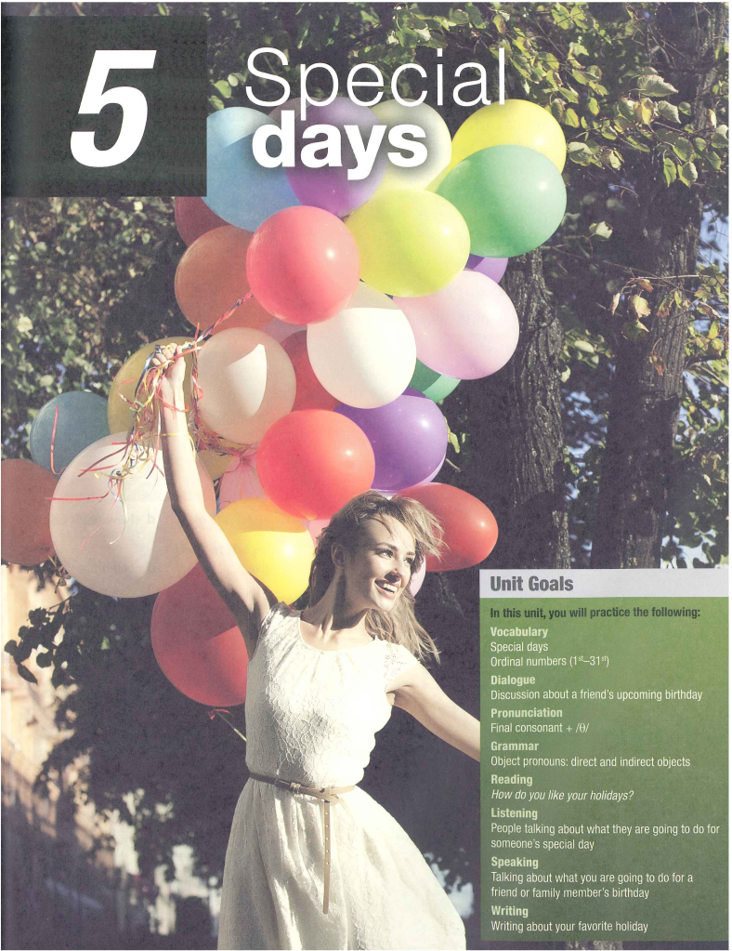

Slide 6
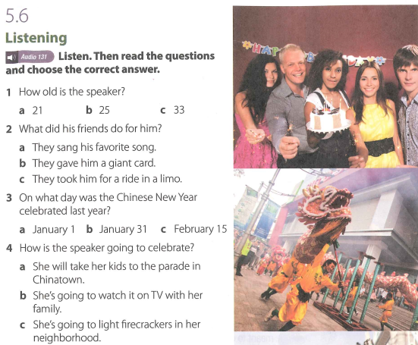

Slide 7
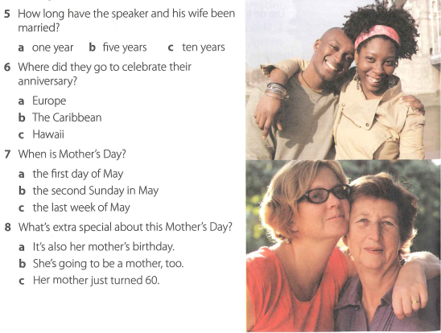

Slide 8
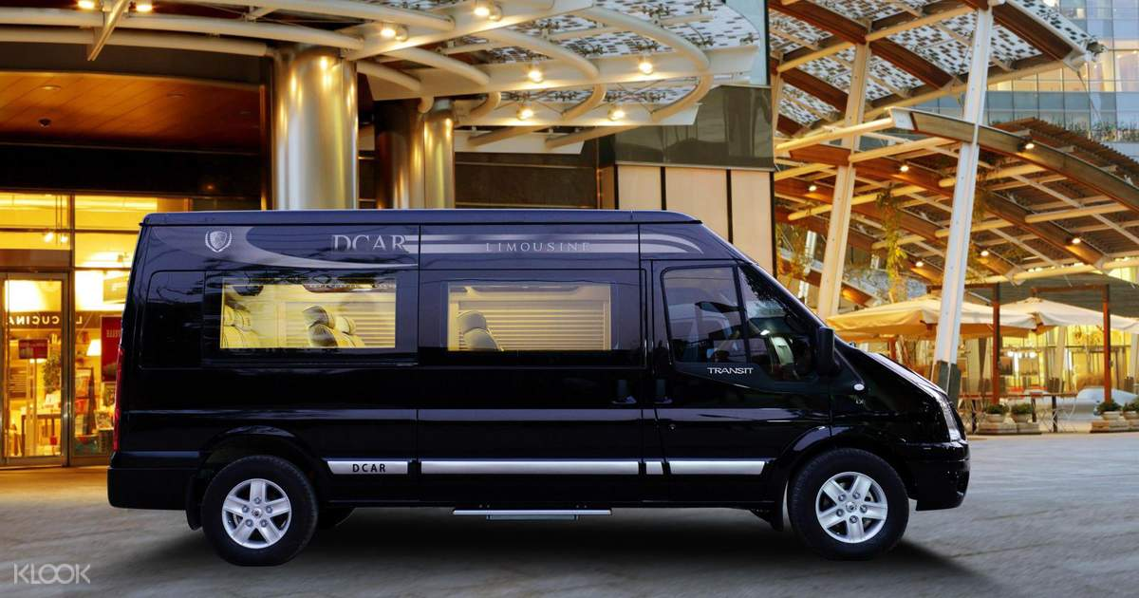
New words:
1. limo (n):

Slide 9
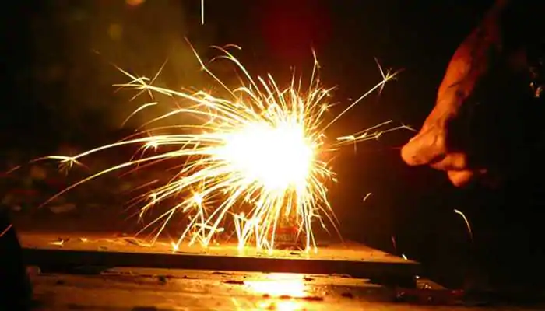
2. firecrackers (n)

Slide 10
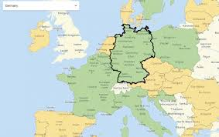
3. Europe (n)

Slide 11
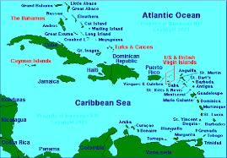
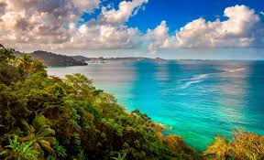
4. the Caribbean (n)

Slide 12
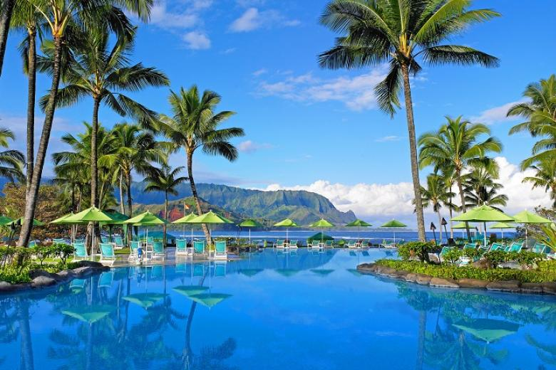
5. Hawaii (n)

Slide 13
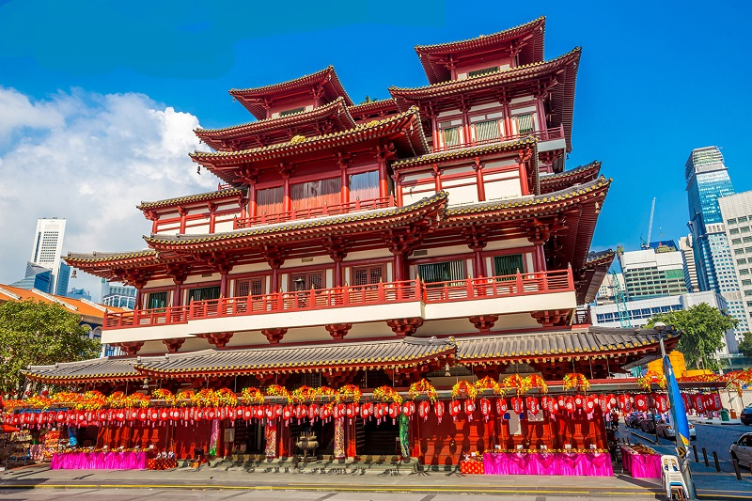
6. Chinatown (n):

Slide 14

7. a giant card (n):

Slide 15
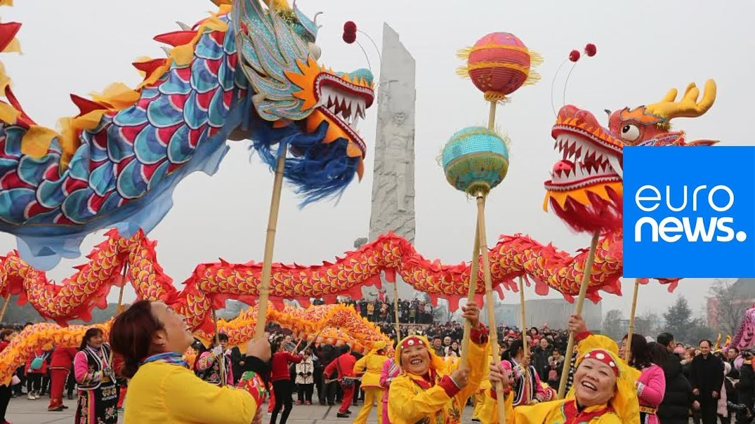
8. The Chinese New Year

Slide 16

9. a big hug (n)

Slide 17
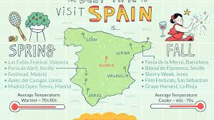
10. Spain (n):

Slide 18
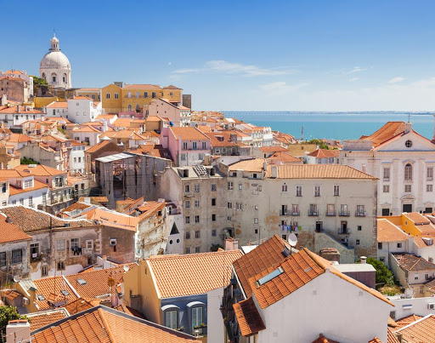
11. Portugal (n):

Slide 19
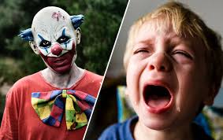
12. scare (v):

Slide 20


Slide 22
5.6 Listening (Key)
1. How old is the speaker?
a. 21 b. 25 c. 33
2. What did his friends do for him?
a. They sang his favorite song.
b. They gave him a giant card.
c. They took him for a ride in a limo.
3. On what day was the Chinese New Year celebrated last year?
a. January 1 b. January 31 c. February 15
4. How is the speaker going to celebrate?
  a. She will take her kids to the parade in Chinatown.
  b. She’s going to watch it on TV with her family.
  c. She’s going to light firecrackers in her neighborhood.

Slide 23
5.6 Listening (Key)
5. How long have the speaker and his wife been married?
a. one year b. five years c. ten years
6. Where did they go to celebrate their anniversary?
a. Europe b. The Caribbean c. Hawaii
7. When is Mother's Day?
a. the first day of May
b. the second Sunday in May
c. the last week of May
8. What’s extra special about this Mother’s Day?
a. It’s also her mother’s birthday.
b. She‘s going to be a mother, too.
c. Her mother just turned 60.

Slide 24
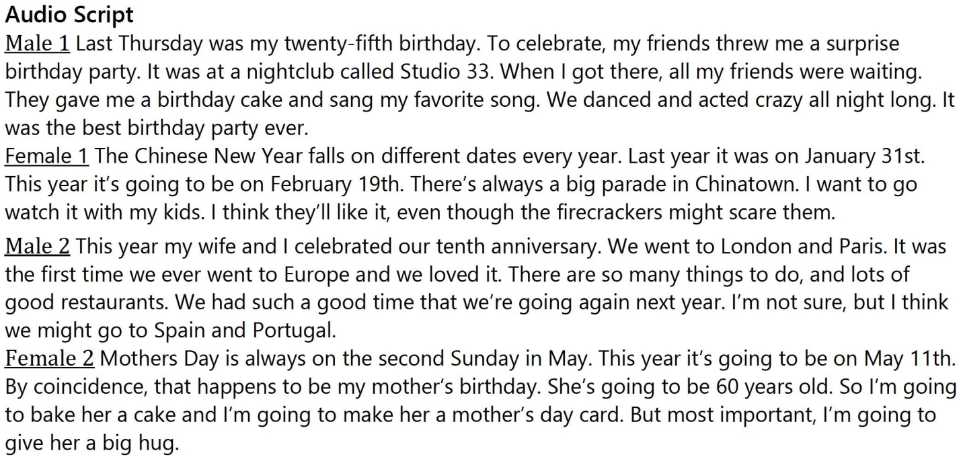

Slide 25
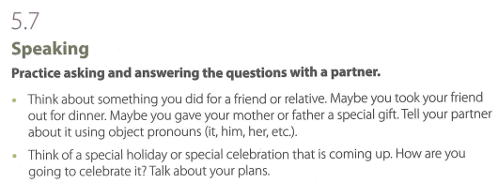

Slide 26
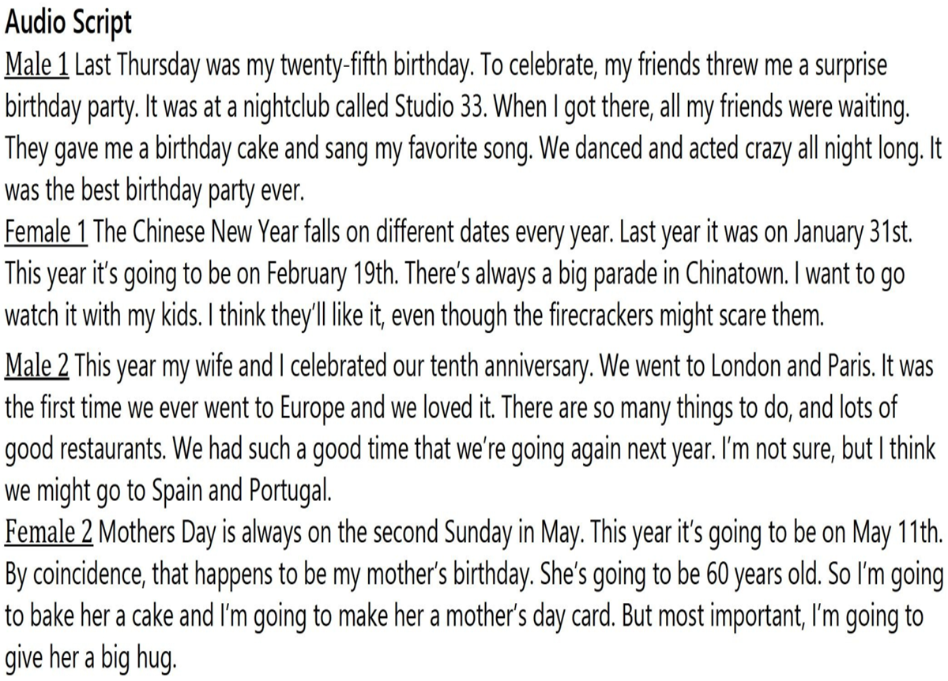

Slide 27
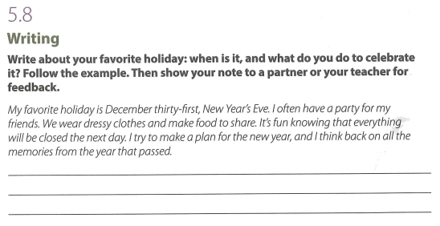

Slide 28
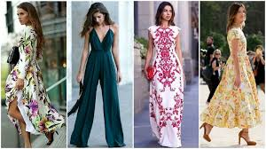
dressy clothes (n)

Slide 30

Thank you very much
for your cooperation.

